Slide 1
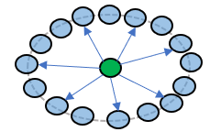
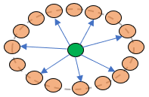
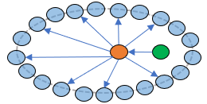
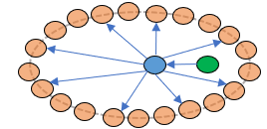
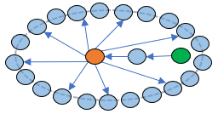
RESULTS OF PIPELINE SEPTEMBER 2022
6,243 cases > 4 HPO
439 solved cases with gene and > 4 HPO
2,385 ORPHAcodes (Active Disorders + Subtypes of disorder : > 4 HPO with gene)
All genes are considerate (and also offsprings’ genes)
Solved case with gene
Unsolved cases
ORPHAcode with gene
A Similar ORPHAcodes Input : all 439 solved cases + all 2,385 ORPHAcodes | 50,480 solved case – ORPHAcodes associations 41,644 different solved case – ORPHAcodes associations 2,437 different genes 193 solved case – ORPHAcodes associations with same gene (A.1)
B.1 Similar cases Input : all 439 solved case + all 6,243 cases | 22,489 solved cases – cases associations (22,300 if we don’t consider the genes of unsolved cases) 21,142 different solved cases – cases associations 4,711 different cases
B.2 Similar ORPHAcodes to similar cases Input : 4,711 cases from B1 + all 2,385 ORPHAcodes | 2,556,063 cases – ORPHAcodes associations 453,134 different cases – ORPHAcodes associations 3,403 different genes
C.1 Similar cases to ORPHAcode with same gene Input : 193 ORPHAcodes from A1 + all 6,243 all cases | 85,064 ORPHAcodes – cases associations (84,019 if we don’t consider the genes of unsolved cases) 46,472 different ORPHAcodes – cases associations 5,887 different cases
C.2 Similar ORPHAcodes to similar cases Input : 5,888 cases from C1 + all 2,385 ORPHAcodes | 708,130 cases – ORPHAcodes associations 575,354 different cases – ORPHAcodes associations 3,458 different genes

